Slide 1
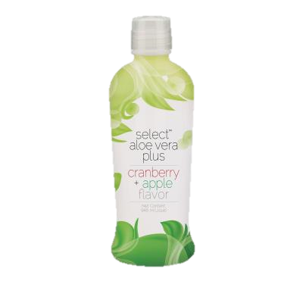
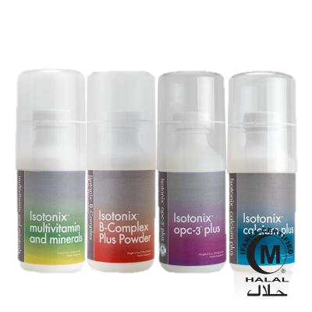
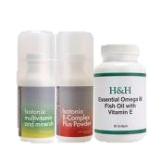
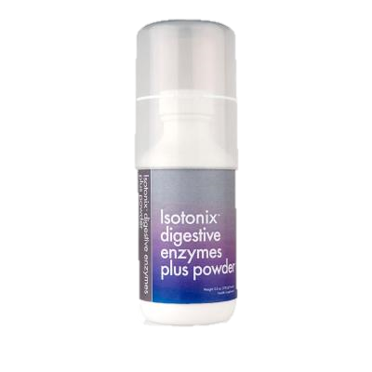
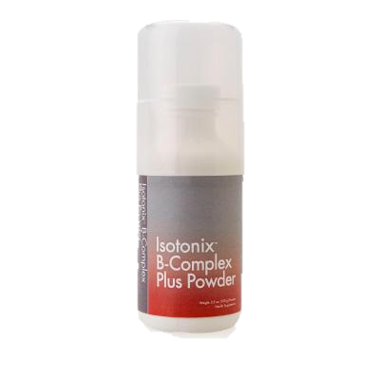
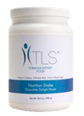
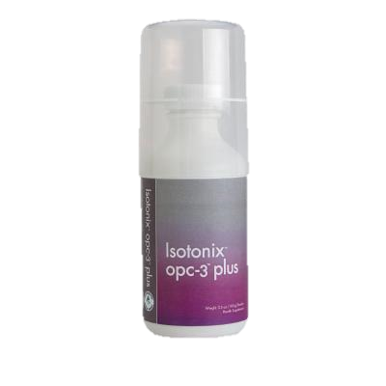
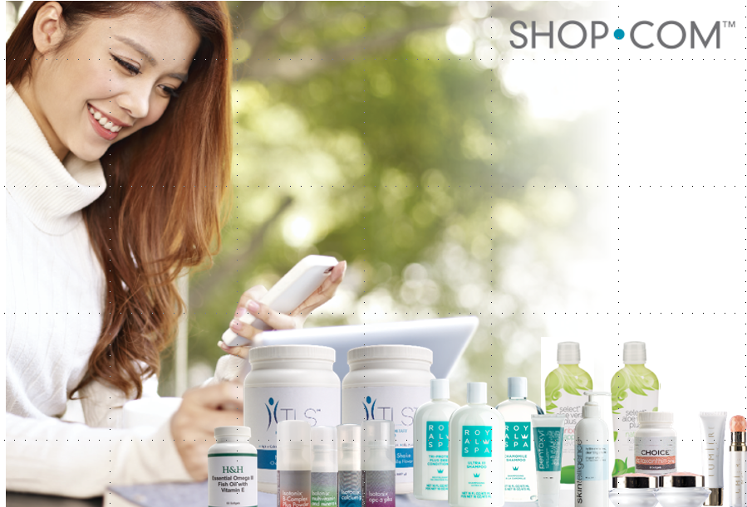
WHICH KIT
YOU?
IS RIGHT FOR
Daily Essential Kit 30 Servings Contains:
1 Isotonix® Multivitamin 100 g bottle
1 Isotonix B-Complex 100 g bottle
1 Isotonix OPC-3 100 g bottle
1 Isotonix Calcium Plus 100 g bottle
Optimal Wellness Kit
H&H™ Essential Omega III Fish Oil with Vitamin E (30 servings)
Isotonix® Multivitamin 100mg
Isotonix® Activated B-Complex 100mg
Digestive Kit Contains:
1 Select Aloe Juice® Strawberry Kiwi Flavor 32 oz
1 NutriClean™ Fiber with L-Glutamine & Probiotics
1 Isotonix Digestive Enzymes with Probiotics 100mg
COST | RM377.00
COST | RM345.00
COST | RM191.00
Business Fast Start Kit
RM1618
Weigh loss :
1 TLS™ Nutrition Shake 14 servings
1 Isotonix Digestive Enzymes with Probiotics 100mg
Stress & Energy Kit Contains:
1 Isotonix® OPC-3 ( 30 Serving)
1 Isotonix® B Complex ( 30 Serving)
COST | RM232.00
COST | RM258
Credit Card Option:
Name: ________________________________________________Email: _________________________________ Phone: __________________________
Address:___________________________________________________________City: _____________________________ State: ___ Zip :____________
Credit Card #: _________________________________________________Exp Date:______________ CVV: _________________
*These statements have not been evaluated by the Food and Drug Administration. These products are not intended to diagnose, treat, cure or prevent any disease

Slide 2
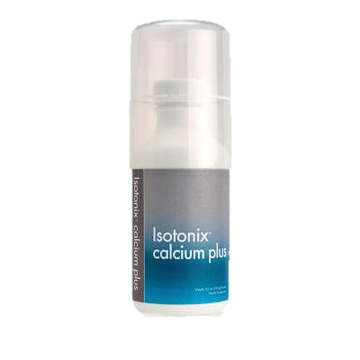
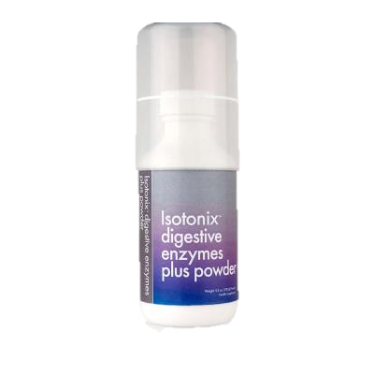
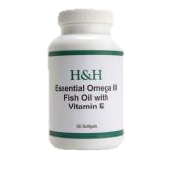

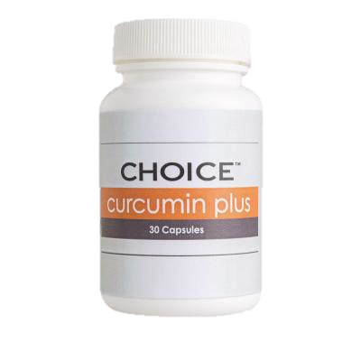
WHICH KIT
YOU?
IS RIGHT FOR
Blood Sugar Balance Contains:
1 Isotonix® OPC-3 ( 30 Serving)
1 Isotonix® Digestive Enzymes ( 30 Serving)
Cholesterol Maintenance Contains:
1 Isotonix® OPC-3 ( 30 Serving)
1 H&H Omega III Fish Oil with Vitamin E ( 60 Soft Gel)
Healthy Blood Pressure Support:
1 Isotonix® OPC-3 ( 30 Serving)
1 Isotonix® Calcium ( 30 Serving)
COST | RM217.00
COST | RM300.00
COST | RM197.00
RM1618
Stress & Energy Kit Contains:
1 Isotonix® OPC-3 ( 30 Serving)
1 Isotonix® B Complex ( 30 Serving)
Seasonal Kit
1 Isotonix® OPC-3 ( 90 Serving)
1 Curcumin Extreme (30 Servings
COST | $258 SGD
COST | RM351
Credit Card Option:
Name: ________________________________________________Email: _________________________________ Phone: __________________________
Address:___________________________________________________________City: _____________________________ State: ___ Zip :____________
Credit Card #: _________________________________________________Exp Date:______________ CVV: _________________
*These statements have not been evaluated by the Food and Drug Administration. These products are not intended to diagnose, treat, cure or prevent any disease

Slide 3
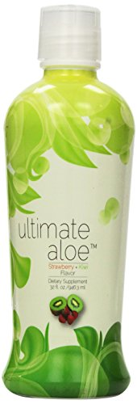
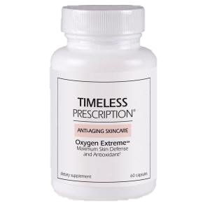
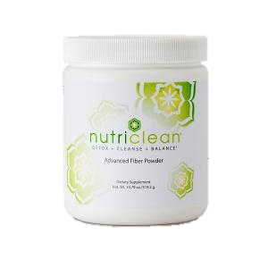
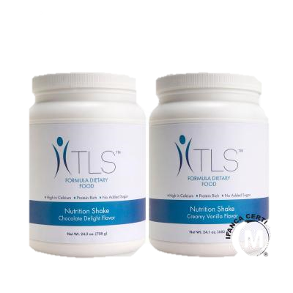
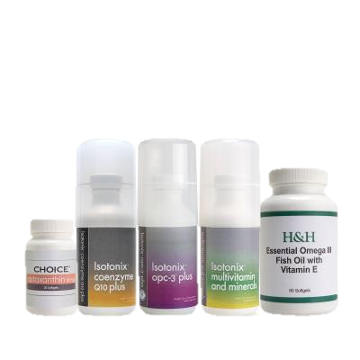

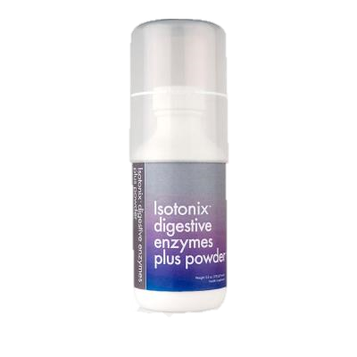
WHICH KIT
YOU?
IS RIGHT FOR
TLS® 30-Day Jump Start Kit:
NutriClean Fiber Powder; 3 Isotonix Digestive Enzymes; 2 TLS Nutrition Shakes – 1 Vanilla; 1 Chocolate; Challenge , Aloe Select, Fiber Powder, Curcumin
7 Day Detox Kit
1 Ultimate Aloe Juice® Strawberry Kiwi Flavor 32 oz
1 NutriClean Fiber Powder;
1 Timeless Oxygen Extreme (30 Servings)
Liver Detox Kit
1 Timeless Oxygen Extreme (30 Servings)
1 Curcumin Extreme (30 Servings
COST | RM866
COST | RM471
COST | RM325
$575 SGD
FIND YOUR FIT KIT
1 Isotonix Digestive Enzymes;
2 TLS Nutrition Shakes – 1 Vanilla; 1 Chocolate;
H&N KIt
1 Isotonix® Multivitamin ( 30 Serving), 1 Isotonix® OPC-3 ( 30 Serving),1 Isotonix® COq10 ( 30 Serving), 1 H&H Omega-3, 1 Astaxanthin
COST | RM301.00
COST | RM781.00
Credit Card Option:
Name: ________________________________________________Email: _________________________________ Phone: __________________________
Address:___________________________________________________________City: _____________________________ State: ___ Zip :____________
Credit Card #: _________________________________________________Exp Date:______________ CVV: _________________
*These statements have not been evaluated by the Food and Drug Administration. These products are not intended to diagnose, treat, cure or prevent any disease

